Slide 1
CompTIA A+ Guide to IT Technical Support
10th Edition

Slide 2
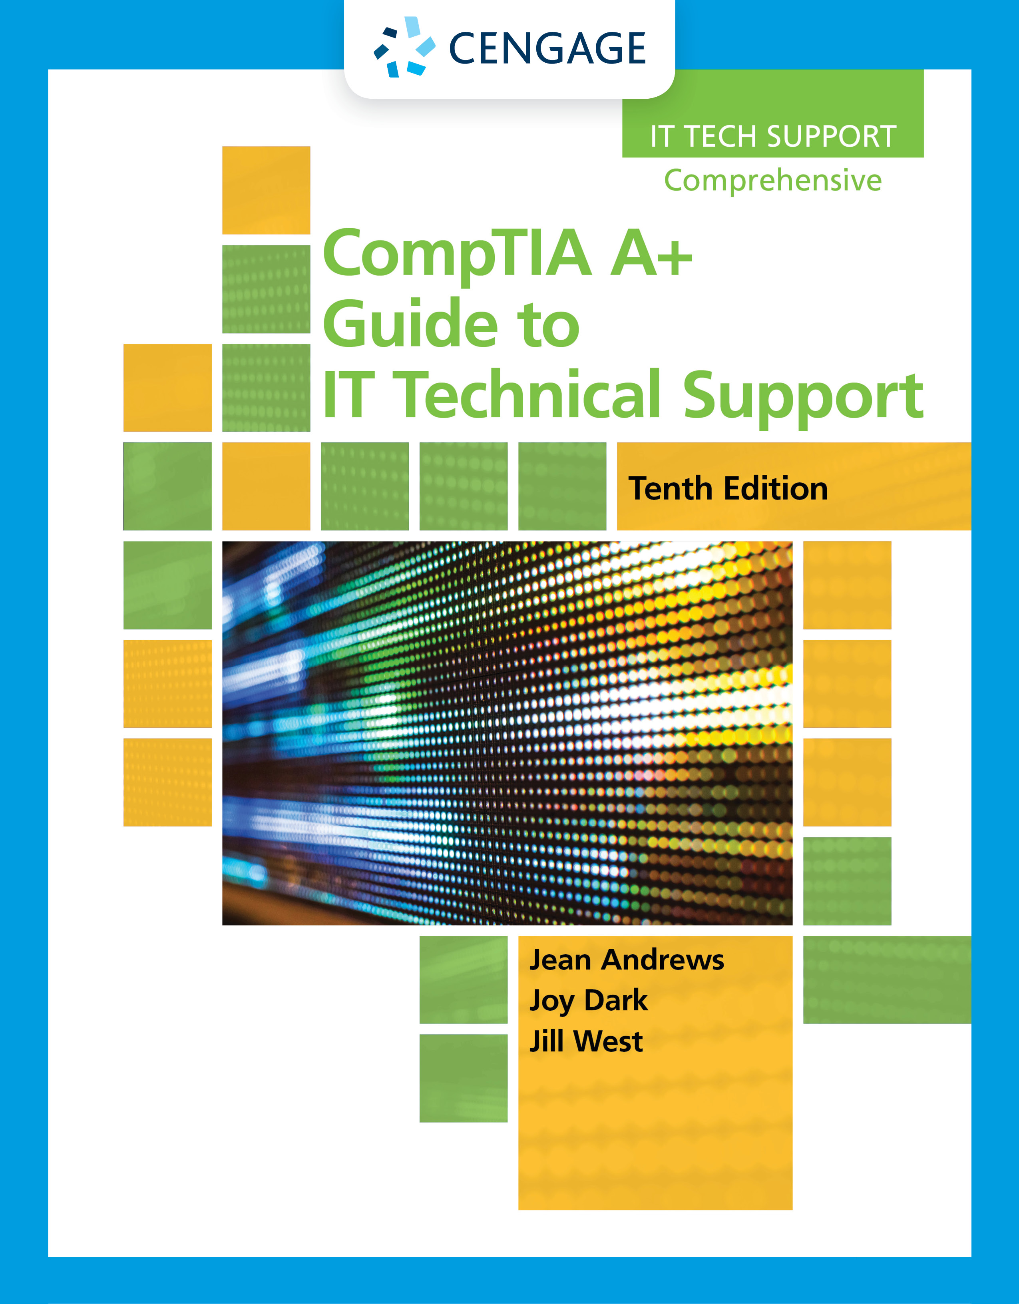
Setting Up a Local Network
Chapter 7

Slide 3
Objectives
Describe network types and the Internet connections they use
Connect a computer to a wired or wireless network
Configure and secure a multifunction router on a local network
Troubleshoot network connections using the command line

Slide 4
Types of Networks and Network Connections
Networks can be categorized by technology used and size of the network
PAN (personal area network): consists of personal devices such as a cell phone and laptop
LAN (local area network): covers a small local area such as a home, office, or other building
WMN (wireless mesh network): covers a limited geographic area and is popular in places where cables are difficult to install
MAN (metropolitan area network): covers a large campus or city
WAN (wide area network): covers a large geographic area and is made up of small networks

Slide 5
Internet Connection Technologies (1 of 13)
Internet Service Provider (ISP): used to connect to the Internet
Most common type of connections are DSL and cable Internet (cable modem)
ISPs devote more available bandwidth to downloading and less of it to uploading
Bandwidth: measure of the maximum data transmission rate
Data throughput: actual network transmission speed
Latency: delays in network transmissions
Measured by the round-trip time it takes for a data packet to travel from source to destination and back

Slide 6
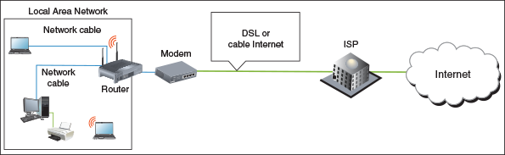
Internet Connection Technologies (2 of 13)
Figure 7-1 An ISP stands between a LAN and the Internet

Slide 7
Internet Connection Technologies (3 of 13)
Compare Cable Internet and DSL
Cable Internet
Uses existing TV cable lines and is always connected (always up)
TV signals and PC data signals share the same coax cable
Cable modem converts PC’s digital signals to analog
And converts incoming analog data to digital
DSL (Digital Subscriber Line)
A group of broadband technologies that covers a wide range of speeds
Uses ordinary copper phone lines and unused voice frequencies
Always connected
Can use the same phone line for voice and DSL at the same time

Slide 8
Internet Connection Technologies (4 of 13)
When deciding between cable Internet vs. DSL:
Both can sometimes be purchased on a sliding scale
Cable modem shares TV cable infrastructure with neighbors
Service may become degraded
DSL uses dedicated phone line
Must filter phone line static
Similar setup for both

Slide 9
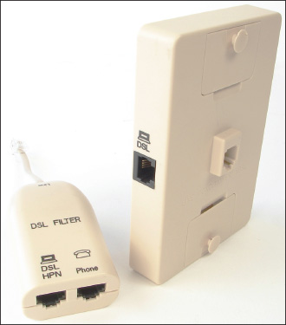
Internet Connection Technologies (5 of 13)
Figure 7-2 When DSL is used in your home, filters are needed on every phone jack except the one used by the DSL modem

Slide 10
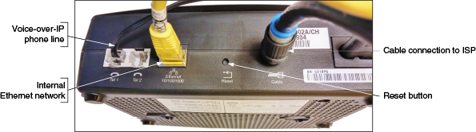
Internet Connection Technologies (6 of 13)
Figure 7-4 Use a cable modem to connect the ISP’s coaxial cable to the LAN’s Ethernet cable

Slide 11
Internet Connection Technologies (7 of 13)
Dedicated Line Using Fiber Optic
Fiber optic is a dedicated point-to-point (PTP) connection
No line sharing
Television, Internet data, and voice communication all share the broadband fiber-optic cable
Upstream and downstream speeds and prices vary
Satellite
Satellite provides high-speed Internet connections in remote areas
Available everywhere (even airplanes)
Disadvantages: requires line-of-site wireless connectivity and latency occurs when uploading

Slide 12
Internet Connection Technologies (8 of 13)
Dial-Up
Dial-up or POTS (plain old telephone service) is the least expensive and slowest connection to the Internet
Cellular WAN
A wireless wide area network (WWAN), also called a cellular network or cellular WAN, covers a wide area
Made up of cells created by base stations
A base station might include more than one transceiver and antenna on the same tower
To support multiple technologies
Two established cellular technologies are GSM and CDMA
Long Term Evolution (LTE) and Voice over LTE (VoLTE) are expected to ultimately replace GSM and CDMA

Slide 13
Internet Connection Technologies (9 of 13)
Cellular WAN (continued)
To connect a computer using mobile broadband to a cellular network, you need the hardware and software to connect and, for most networks, a SIM (Subscriber Identification Module) card
Options for software and hardware devices that can connect to a cellular network:
Embedded mobile broadband modem
Cell phone tethering
USB broadband modem
LTE installed Internet
Mobile hotspot

Slide 14
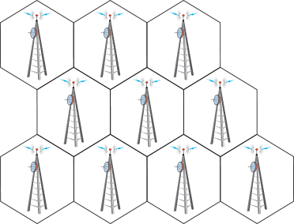
Internet Connection Technologies (10 of 13)
Figure 7-6 A cellular WAN is made up of many cells that provide coverage over a wide area

Slide 15
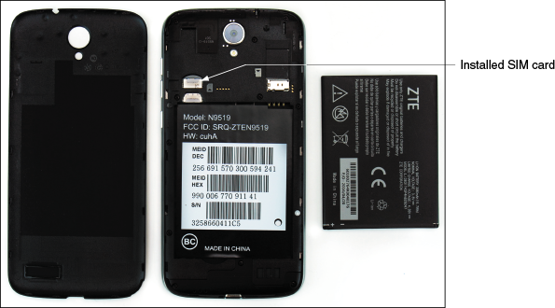
Internet Connection Technologies (11 of 13)
Figure 7-7 A SIM card contains proof that your device can use a cellular network

Slide 16
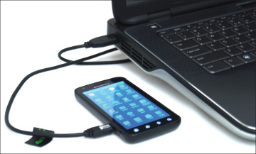
Internet Connection Technologies (12 of 13)
Figure 7-8 Tether your laptop to your cell phone using a USB cable

Slide 17
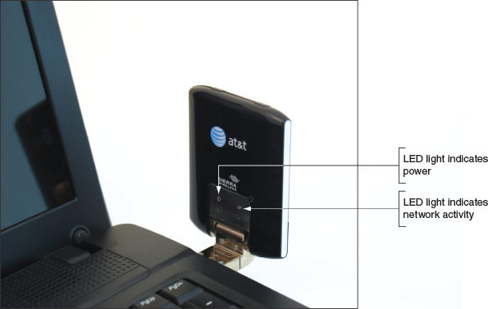
Internet Connection Technologies (13 of 13)
Figure 7-9 A USB broadband modem by Sierra Wireless

Slide 18
Connecting a Computer to a Local Network
Connecting a laptop or desktop computer to a network is quick and easy in most situations
Topics covered in this section:
How to connect to a wired or wireless network
How to connect to a VPN

Slide 19
Connecting to an Ethernet Wired or Wi-Fi Wireless Local Network (1 of 6)
To connect a computer to a network using a wired or wireless connection, follow these steps:
1. Install network adapter and drivers
2. For a wired network:
Connect network cable to Ethernet RJ-45 port and network port
Verify lights
Windows should automatically configure connection
For a wireless network:
Click the Network icon and select a wireless network, click Connect
If network is secured, must enter a security key

Slide 20
Connecting to an Ethernet Wired or Wi-Fi Wireless Local Network (2 of 6)
To connect a computer to a network using a wired or wireless connection, follow these steps (continued):
3. If this is the first time you’ve connected to a local network, you will be asked if you want to make the PC discoverable
For private networks, click Yes and for public networks, click No
4. Open browser and verify Internet connectivity
For some hotspots, an initial page (called a captive portal) appears and you must enter a code or agree to the terms of use
On a private network, open File Explorer or Windows Explorer and drill down into the Network group to verify that network resources are available
To view and change network security settings in Windows 10, open the Setting app and click Network & Internet
Click Change connection properties, and then select either Public or Private

Slide 21
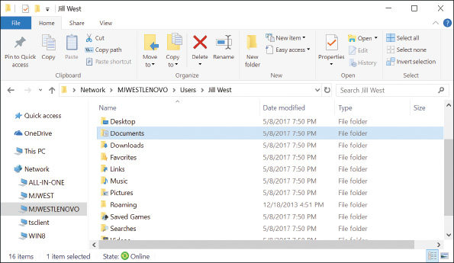
Connecting to an Ethernet Wired or Wi-Fi Wireless Local Network (3 of 6)
Figure 7-12 File Explorer shows resources on the network

Slide 22
Connecting to an Ethernet Wired or Wi-Fi Wireless Local Network (4 of 6)
For wireless connections, view the status of the connection:
1. Open Control Panel and open Network and Sharing Center
Click Change adapter settings and the Network Connections window appears
2. In the Network Connections window, right-click the Wi-Fi connection and click Status
In the Wi-Fi Status box, click Wireless Properties, select the Security tab
To view the security key, check Show characters
If you have a problem making a network connection, you can reset the connection
Open the Network Connections window and right-click the network connection
Select Disable from the shortcut menu
Right-click the connection again and select Enable

Slide 23
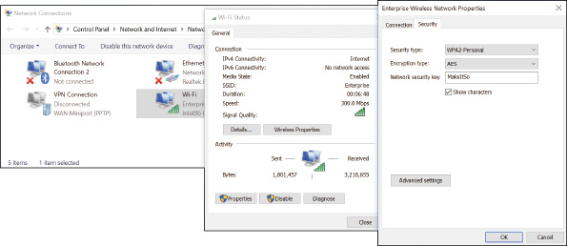
Connecting to an Ethernet Wired or Wi-Fi Wireless Local Network (5 of 6)
Figure 7-15 Verify that the Network security key for the wireless network is correct

Slide 24
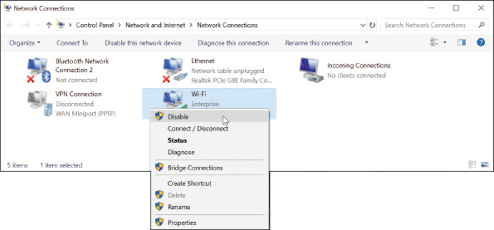
Connecting to an Ethernet Wired or Wi-Fi Wireless Local Network (6 of 6)
Figure 7-16 To repair a connection, disable and then enable the connection

Slide 25
Creating a VPN Connection (1 of 3)
A virtual private network (VPN) is used by telecommuting employees to connect to a corporate network by way of the Internet
Data is encrypted using a technique called a tunnel or tunneling
The VPN can be managed by operating systems, routers, or third-party software
VPN connection is a virtual connection
Setting up a tunnel over an existing connection
When creating a VPN connection, always follow directions given by the network administrator who hosts the VPN

Slide 26
Creating a VPN Connection (2 of 3)
General steps to connect to VPN using Windows:
1. In Network and Sharing Center, click Set up a new connection or network, click Connect to a workplace – Set up a dial-up or VPN connection to your workplace, click Next
2. In the Connect to a Workplace box, click Use my Internet connection (VPN), enter IP address or domain name of the network, name the VPN connection and click Create
Whenever you want to use the VPN connection, click the Network icon in the taskbar
In the list of available networks, click the VPN connection and click Connect
Enter your user name and password and click OK
Problems connecting to a VPN can be caused by the wrong authentication protocols used when passing the user name and password
Click on the Properties of the VPN Connection to configure security settings

Slide 27
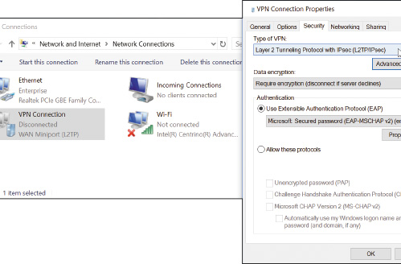
Creating a VPN Connection (3 of 3)
Figure 7-21 Configure the VPN’s security settings

Slide 28
Creating a Dial-Up Connection (1 of 2)
Bare-bones installation steps:
Install internal or external dial-up modem
Plug phone line into computer modem port and wall jack
Open Network and Sharing Center window, click Set up a connection or network, select Connect to the Internet - Set up a broadband or dial-up connection, click Next
Click Dial-up, enter ISP information, click Create
To use the connection:
Click your Network icon in the taskbar
Select dial-up connection, click Connect, click Dial
You will hear modem dial up the ISP and make the connection

Slide 29
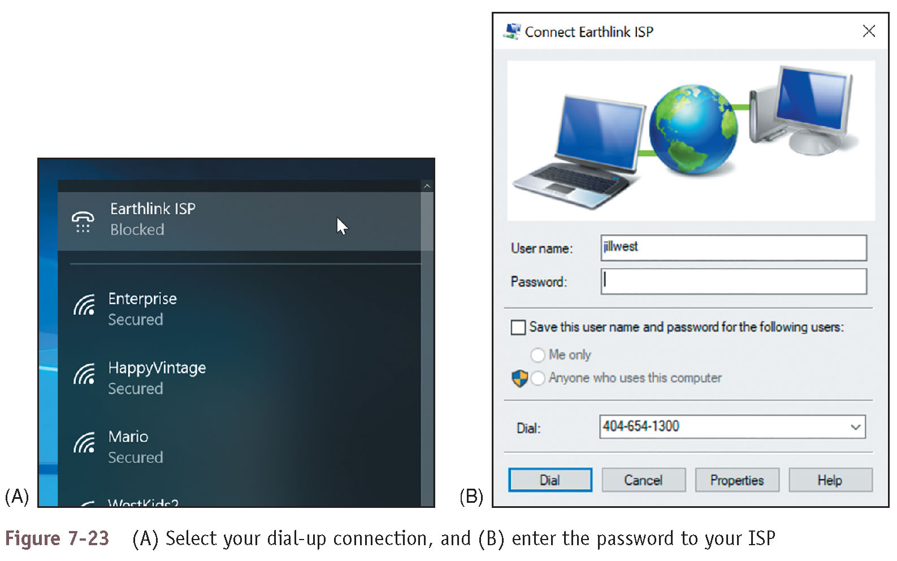
Creating a Dial-Up Connection (2 of 2)
Figure 7-23 (A) Select your dial-up connection, and (B) enter the password to your ISP

Slide 30
Dynamic and Static IP Configurations (1 of 4)
Computers use IP addresses to find each other on a network
An IP address is assigned to a network connection when the connection is first made and can be:
A 32-bit string, written as four decimal numbers called octets and separated by periods
A 128-bit string, written as eight hexadecimal numbers separated by colons
Most networks use 32-bit IP addresses
Defined by IPv4 (Internet Protocol version 4)
Some networks use both 32-bit addresses and 128-bit addresses
128-bit addresses are defined by IPv6 (Internet Protocol version 6)

Slide 31
Dynamic and Static IP Configurations (2 of 4)
A host is any device on a network that requests or serves up data or services to other devices
To communicate on a network or the Internet, a host needs:
Its own IP address – for example, 192.168.100.4
A subnet mask – for example, 255.255.255.0
The IP address of a default gateway, which is used to send data to other networks
The IP address of one or more DNS (Domain Name System) servers
The above information can be manually assigned to a computer’s network connection
The computer’s IP address would then be called a static IP address
This information can be requested from a server on the network (called a DHCP or Dynamic Host Configuration Protocol server)
IP address received is called a dynamic IP address

Slide 32
Dynamic and Static IP Configurations (3 of 4)
To configure dynamic and static IP addresses:
Open Network Connections window, right-click network connection and select Properties
On properties box, click Networking tab
Select Internet Protocol Version 4 (TCP/IPv4) and click Properties
Default setting is dynamic IP addressing
To change to static select Use the following IP address
Enter IP address, subnet mask, and default gateway
If your network administrator has given you the IP addresses of DNS server, select Use the following DNS server addresses and enter up to two IP addresses

Slide 33
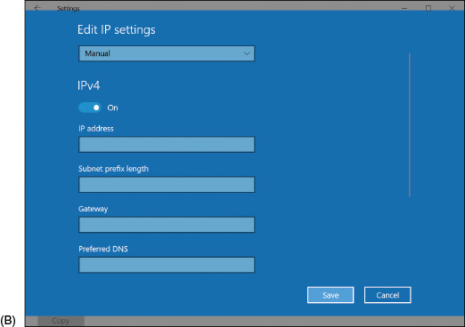
Dynamic and Static IP Configurations (4 of 4)
Figure 7-25 Set static IP addressing information in the Settings app

Slide 34
Alternate IP Address Configuration (1 of 2)
If using a laptop that moves from one network to another and one network uses static:
Use the General tab of the TCP/IPv4 Properties box
Click Alternate Configuration tab and select User configured to enter static IP address information
Click OK and close all boxes

Slide 35
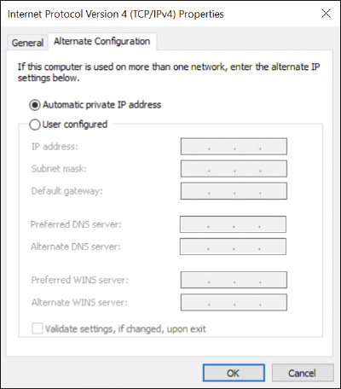
Alternate IP Address Configuration (2 of 2)
Figure 7-26 Create an alternate static IP address configuration

Slide 36
Managing Network Adapters (1 of 2)
A computer makes a wired or wireless connection to a local network using a network adapter
It might be a network port on the motherboard or a network interface card (NIC)
It may also be an external device connected via a USB port
Features to be aware of on an adapter:
The drivers a NIC uses
Ethernet speeds
Full duplex sends and receives transmissions at the same time
Half duplex works in only one direction at a time
MAC address – every network adapter has one
48-bit unique ID number hard-coded by manufacturer

Slide 37
Managing Network Adapters (2 of 2)
Features to be aware of on an adapter (continued):
Status indicator lights
Wake-on-LAN – wakes up the computer when it receives certain communication on the network
For an onboard NIC, you must enable Wake-on-LAN in BIOS/UEFI setup
Quality of Service (QoS)
Ability to control which applications have priority on the network
Must be configured on the router and the network adapter of each computer

Slide 38
Setting Up a Multifunction Router for a SOHO Network
In order to setup a SOHO (small office or home office) network you need to know:
How to configure a multipurpose router to stand between the network and the Internet
A router is a device that manages traffic between two or more networks
Can help find the best path for traffic to get from one network to another

Slide 39
Functions of a SOHO Router
A typical SOHO router usually combines these features:
As a router, it stands between the ISP network and the local network, routes traffic between
As a switch, it manages several network ports that can be connected to wired computers or other network devices
As a DHCP server, all computers receive their IP address from this server
As a wireless access point (WAP), a wireless computer can connect to the Internet
As a firewall, it blocks unwanted traffic from the Internet and can restrict Internet access for local devices behind the firewall
If the router is used as an FTP (File Transfer Protocol) server, you can connect an external hard drive and FTP firmware on router can be used to share files with network users

Slide 40
Installing and Configuring a Router on the Local Network (1 of 3)
When deciding where to physically place a router, consider its physical security
For best security, place the router behind a locked door accessible only to authorized personnel
Also, make sure it is centrally located to create the best Wi-Fi hotspot for users
For routers that have external antennas, raise the antennas to vertical positions
General steps to configure a router:
1. Open browser and enter IP address of router
Enter admin as the user name (or whatever user name is assigned)
2. Use menus on the main setup page of the router firmware to change router’s configuration
Every router is different so poke around until you find the setting you need to configure
When finished, save changes, click Logout, and close browser window

Slide 41
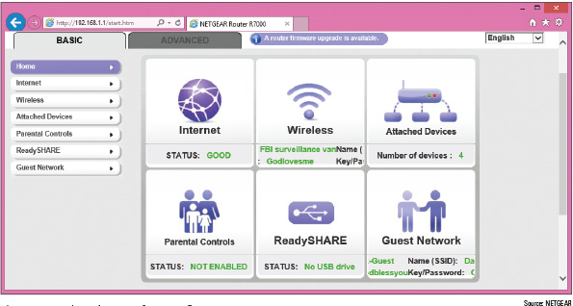
Installing and Configuring a Router on the Local Network (2 of 3)
Figure 7-39 The main screen for router firmware setup

Slide 42
Installing and Configuring a Router on the Local Network (3 of 3)
Changes you might need to make to the router’s configuration:
Change the router password
Configure the DHCP server
Reserve IP addresses
MAC address filtering
QOS for an application or device
Universal Plug and Play (UPnP)
Update router firmware

Slide 43
Limiting Internet Traffic on Your Network (1 of 8)
A router’s firewall can examine each message coming from the Internet
Decides if the message is allowed onto the network
A message is directed to a particular computer and to a particular application running on that computer
The application is identified by a port number, also called a port or port address
Routers offer the option to disable (close) all ports
Means no activity from the Internet can get in
You must specify exceptions to this firewall rule in order to allow unsolicited traffic from the Internet
Exceptions are allowed using port forwarding or a DMZ

Slide 44
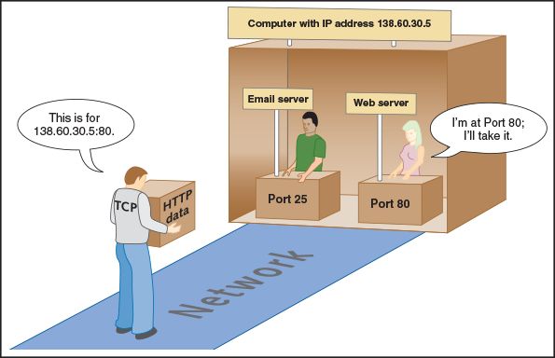
Limiting Internet Traffic on Your Network (2 of 8)
Figure 7-48 Each server application running on a computer is addressed by a unique port number

Slide 45
Limiting Internet Traffic on Your Network (3 of 8)
Port Forwarding
Port Forwarding: when a firewall receives a request for communication from the Internet to a specific computer and port, the request will be allowed and forwarded to that computer
Tips when using port forwarding:
You must lease a static IP address from your ISP
For port forwarding to work, the computer on your network must have a static IP address
Using port forwarding, your computer and network are more vulnerable
You are allowing external users directly into your private network

Slide 46
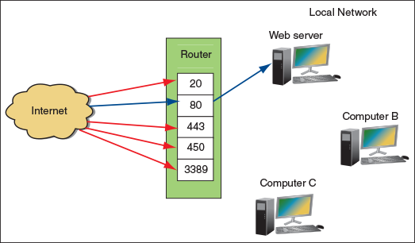
Limiting Internet Traffic on Your Network (4 of 8)
Figure 7-49 Port forwarding on a network

Slide 47
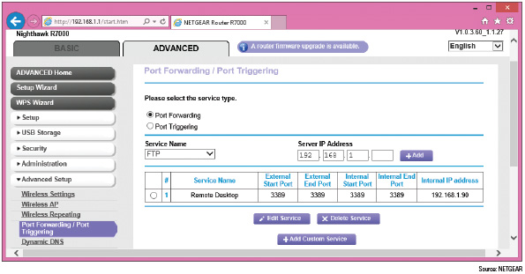
Limiting Internet Traffic on Your Network (5 of 8)
Figure 7-50 Using port forwarding, activity initiated from the Internet is allowed access to a computer on the network

Slide 48
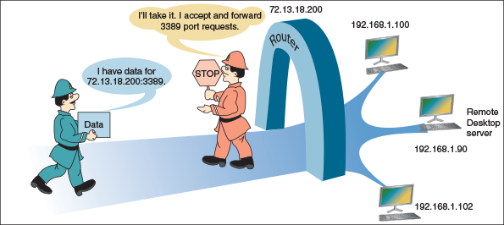
Limiting Internet Traffic on Your Network (6 of 8)
Figure 7-51 With port forwarding, a router allows messages past the firewall that are initiated outside the network

Slide 49
Limiting Internet Traffic on Your Network (7 of 8)
DMZ
A DMZ (demilitarized zone) is a computer or network that is not protected by a firewall
If having problems getting port forwarding to work, put it in the DMZ zone
Content Filtering and Parental Controls
Routers normally provide a way for employers and parents to limit the content computers on the local network can access on the Internet
Can apply to specific computers, users, websites, categories of websites, keywords, services, time of day, and day of week
Criteria for filtering can draw from blacklists (lists of what cannot be accessed) or whitelists (lists of what can be accessed)

Slide 50
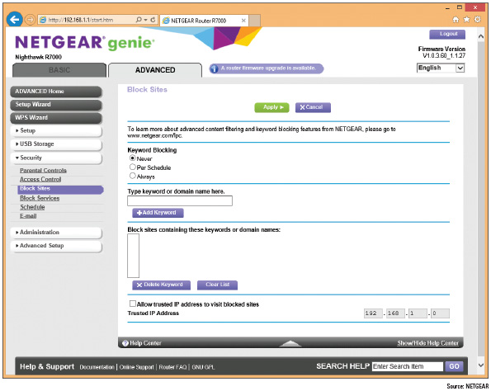
Limiting Internet Traffic on Your Network (8 of 8)
Figure 7-53 Block sites by keyword or domain names

Slide 51
Setting Up a Wireless Network (1 of 7)
Wi-Fi (Wireless Fidelity) standards have evolved over the years
Technical name is IEEE 802.11 standards
Wi-Fi standards:
802.11a – range up to 50 meters and radio frequency of 5.0 GHz
802.11b – range of 100 meters and radio frequency of 2.4 GHz
802.11g – same range and frequency as 802.11b but with faster speeds up to 54 Mbps
802.11n – uses either 5.0-GHz or 2.4-GHz frequency with an indoor range up to 70 meters and outdoor range up to 250 meters
802.11ac – uses the 5.0-GHz frequency and has the same ranges as 802.11n, except performance stays stronger at the edges of its reach

Slide 52
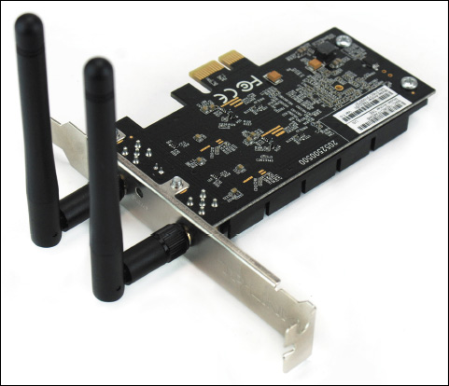
Setting Up a Wireless Network (2 of 7)
Figure 7-54 A wireless network adapter with two antennas supports 802.11a/b/g/n/ac Wi-Fi standards

Slide 53
Setting Up a Wireless Network (3 of 7)
Security Key
Most common and effective method of securing a wireless network is to require a security key
Data is encrypted using an encryption standard
Use the router firmware to set the security key
Best to enter a security key that is different from the password you use to the router utility

Slide 54
Setting Up a Wireless Network (4 of 7)
Set Encryption
The main security standards for 802.11 wireless networks:
WEP (Wired Equivalent Privacy) – no longer considered secure because key used for encryption is static
WPA (Wi-Fi Protected Access) – also called TKIP and is stronger than WEP because encryptions keys are constantly changing
WPA2 (also called 802.11i standard) – latest and best encryption standard
WPA3 offers better encryption and additional features over WPA2

Slide 55
Setting Up a Wireless Network (5 of 7)
Change the Default SSID and Disable SSID Broadcasting
The Service Set Identifier (SSID) is the name of the wireless network
Not considered a strong security method because software can be used to discover an SSID that is not broadcasted
Select Channels for the WLAN
Channel: a specific radio frequency within a broader frequency
In the US, 11 channels are available for wireless networks
If experiencing interference, you can set each network to a different channel
Radio Power Levels
Some high-end APs allow you to adjust radio power levels to reduce interference, limit the range of the network, or to save on electricity

Slide 56
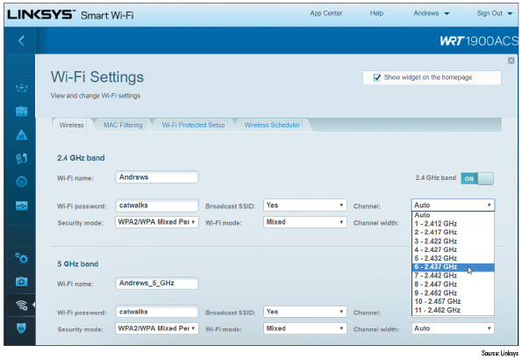
Setting Up a Wireless Network (6 of 7)
Figure 7-56 Select a channel in the 2.4-GHz band

Slide 57
Setting Up a Wireless Network (7 of 7)
Wireless QoS
For wireless devices, you can improve QoS by enabling WMM (Wi-Fi Multimedia)
When WMM is enabled, the wireless access point will prioritize wireless traffic for audio, video, and voice over other types of wireless network traffic
Wi-Fi Protected Setup (WPS)
Generates the SSID and security key using a random string of hard-to-guess letters and numbers
WPS might be a security risk if not managed well
Turn on auto disable so that WPS will disable after a few failed PIN entries

Slide 58
Troubleshooting Network Connections
Windows includes several utilities you can use to troubleshoot networking problems:
ping
ipconfig
nslookup
tracert
Two net commands
netstat

Slide 59
Ping [-A] [-T] [Targetname] (1 of 2)
The ping command tests connectivity by sending an echo request to a remote computer
If the remote computer is online, detects the signal, and is configured to respond to a ping, it responds
Use ping to test for connectivity or to verify that DNS is working

Slide 60
Ping [-A] [-T] [Targetname] (2 of 2)
Ping Command | Description
ping 69.32.208.75 | Ping tests for connectivity using an IP address. If the remote computer responds, the round-trip times are displayed.
ping –a 69.32.208.75 | The –a parameter tests for name resolution. Use it to display the host name and verify that DNS is working.
ping –t 69.32.208.75 | The –t parameter causes pinging to continue until interrupted. To display statistics, press Ctrl+Break. To stop pinging, press Ctrl+C.
ping 127.0.0.1 | This is called a loopback address test. The IP address 127.0.0.1 always refers to the local computer. If the local computer does not respond, you can assume there is a problem with the network connection’s configuration.
ping cengage.com | Use a host name to find out the IP address of a remote computer. If the computer does not respond, suspect there is a problem with DNS. On the other hand, some computers are not configured to respond to pings.

Slide 61
Ipconfig [/all] [/release] [/renew] [/displaydns] [/flushdns] (1 of 2)
The ipconfig (IP configuration) command can display network configuration information
And refresh the TCP/IP assignments for a connection

Slide 62
Ipconfig [/all] [/release] [/renew] [/displaydns] [/flushdns] (2 of 2)
Ipconfig Command | Description
ipconfig /all | Displays a network connection’s configuration information, including the MAC address.
ipconfig /release | Releases the IP address and other TCP/IP assignments when dynamic IP addressing is being used.
ipconfig /release6 | Releases an IPv6 address and other TCP/IP assignments.
ipconfig /renew | Leases a new IP address from a DHCP server. Make sure you release the IP address before you renew it.
ipconfig /renew6 | Leases a new IPv6 address from a DHCP IPv6 server. Make sure you release the IPv6 address before you renew it.
ipconfig /displaydns | Displays information about name resolutions that Windows currently holds in the DNS resolver cache.
ipconfig /flushdns | Flushes the name resolver cache, which might solve a problem when the browser cannot find a host on the Internet.

Slide 63
Nslookup [Computername] (1 of 2)
The nslookup (namespace lookup or name server lookup) command is used to test name resolution problems with DNS servers
Allows you to request information from a DNS server’s zone data
Zone data is the portion of the DNS namespace that the server knows about
A reverse lookup is when you use the nslookup command to find the host name when you know the IP address

Slide 64
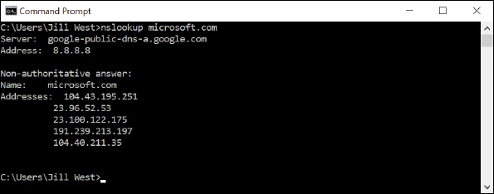
Nslookup [Computername] (2 of 2)
Figure 7-60 The nslookup command reports information about the Internet namespace

Slide 65
Tracert [targetname] (1 of 2)
The tracert (trace route) command can be useful when trying to resolve a problem reaching a destination host
The command sends a series of requests to the destination computer and displays each hop to the destination
A hop happens when a packet moves from one router to another
A message is assigned a Time To Live (TTL), which is the number of hop counts it can make before a router drops the packet and sends an ICMP message back to the host that sent packet

Slide 66
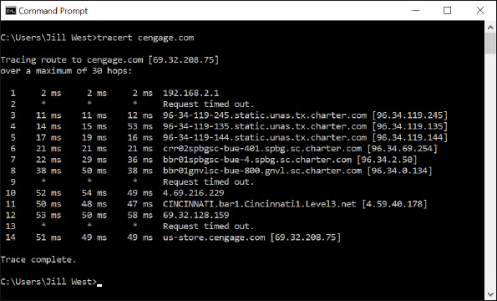
Tracert [targetname] (2 of 2)
Figure 7-61 The tracert command traces a path to a destination computer

Slide 67
The Net Commands
The net command is several commands in one
Most require an elevated command prompt window
Net use command connects or disconnects a computer from a shared resource
Use the following command to pass a user name and password to the \\bluelight remote computer, and then map a network drive to the /Medical folder on that computer:
net use \\bluelight\Medical /user:”Jean Andrews” mypassword
net use z: \\bluelight\Medical
Net user command manages user accounts

Slide 68
Netstat [-A] [-B] [-O] (1 of 2)
The netstat (network statistics) command gives statistics about network activity and includes several parameters

Slide 69
Netstat [-A] [-B] [-O] (2 of 2)
Netstat Command | Description
netstat | Lists statistics about the network connection, including the IP addresses of active connections.
netstat >>netlog.txt | Directs output to a text file.
netstat –b | Lists programs that are using the connection and is useful for finding malware that might be using the network. The –b switch requires an elevated command prompt.
netstat –b –o | Includes the process ID of each program listed. When you know the process ID, you can use the taskkill command to kill the process.
netstat –a | Lists statistics about all active connections and the ports the computer is listening on.

Slide 70
Chapter Summary (1 of 2)
Networks are categorized in size as a PAN, LAN, Wireless LAN, MAN, or WAN
Network performance is measured in bandwidth and latency
Two most popular ways to connect to the Internet are cable Internet and DSL
A VPN protects data by encrypting it from the time it leaves the remote computer until it reaches a server on the corporate network
A host needs an IP address, subnet mask, default gateway, and IP addresses for DNS servers to communicate with other hosts on the local or remote networks
Network adapters, commonly called NICs, are rated by speed and each has a MAC address

Slide 71
Chapter Summary (2 of 2)
A multifunction router for a SOHO network might serve several functions including a router, a switch, a DHCP server, a wireless access point, a firewall, and an FTP server
Change the router’s password as soon as you install it
To allow certain traffic initiated from the Internet past your firewall, you can use port forwarding, a DMZ, and content filtering with whitelists or blacklists
To secure a wireless access point, require a security key, disable SSID broadcasting, and enable encryption (WPA2, WPA, or WEP)
Useful Windows command-line utilities for network troubleshooting are ping, ipconfig, nslookup, tracert, net use, net user, and netstat

